Slide 1


Analysis of and Mitigation Strategies for Real World ICS Security Incidents
Nico Fechtner
nico.fechtner@tum.de
July 9, 2020
Notes:
Outcome of a seminar paper I wrote
Testrun for next week
Very much appreciate feedback
ICS: controls industrial plants, manufacturing sites, power grids etc. -> Different from classic IT: Specialized HW & SW. Highly reliable and safe (nuclear enrichment facility)

Slide 2
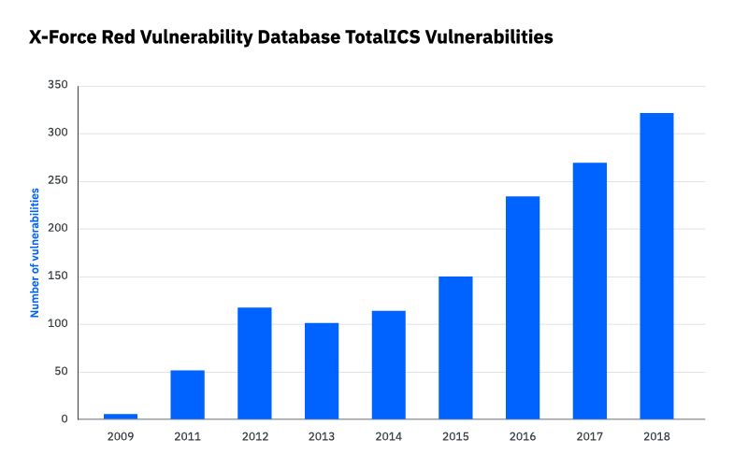
Motivation: Growing ICS Threat Landscape
https://securityintelligence.com/posts/industrial-control-systems-security-to-test-or-not-to-test/
2
Notes:
IBMs X-Force Red offers penetration testing
Simon: ICS initially were not connected to the internet, but now are (IIoT)

Slide 3
Problem Statement
Defend against ICS attacks
Avoid known/common mistakes
Learn from past incidents
Comparative overview of historic incidents
+
In-depth analyses of individual incidents
3
Notes:
If company A & B fall victim to a certain attack, company C shouldn’t fall victim to the same attack a few months later
Identify repeating patterns
Get a deeper understanding of threats specific to our environment

Slide 4
Agenda
Motivation & Problem Statement
Comparative Overview of ICS Security Incidents
Case Study: The Triton Attack
Conclusion & Future Work
4

Slide 5
Agenda
Motivation & Problem Statement
Comparative Overview of ICS Security Incidents
Case Study: The Triton Attack
Conclusion & Future Work
5

Slide 6
Analyzed Incidents
Comparative Overview of ICS Security Incidents
Incident enumerations (Risi database, ICS-CERT alerts)
Threat reports from ICS security companies
Papers / conference talks dedicated to single incidents
Press releases / blog posts dedicated to single incidents
27 incidents analyzed (2000 - 2019)
6
Notes:
Multiple publicly available sources that provide information on ICS security incidents
(How did I select the incidents? Most “relevant” / most citations)

Slide 7
Attack Type
Comparative Overview of ICS Security Incidents
Targeted vs. untargeted
7

Slide 8
Attack Type
Comparative Overview of ICS Security Incidents
What percentage of attacks were targeted?
8

Slide 9
Attack Type
Comparative Overview of ICS Security Incidents
9
Notes:
How many of the campaigns were targeted?
1 Untargeted attack can affect thousands of victims

Slide 10
Targets: Economic Sector
Comparative Overview of ICS Security Incidents
Which economic sectors were affected most often (aviation, chemical, energy, water,…)?
10

Slide 11
Targets: Economic Sector
Comparative Overview of ICS Security Incidents
11
Notes:
Energy: Power grids, oil & gas pipelines
Manufacturing: German steel mill, aluminium production
Petrochemical: (Triton)
Technology: (BitPaymer: targeted ransomware)
Government: diplomatic service agancies (RedOctober)
Aviation: (Havex: espionage campaign)

Slide 12
Targets: Geographic Location
Comparative Overview of ICS Security Incidents
Which countries/regions were affected most often?
12

Slide 13
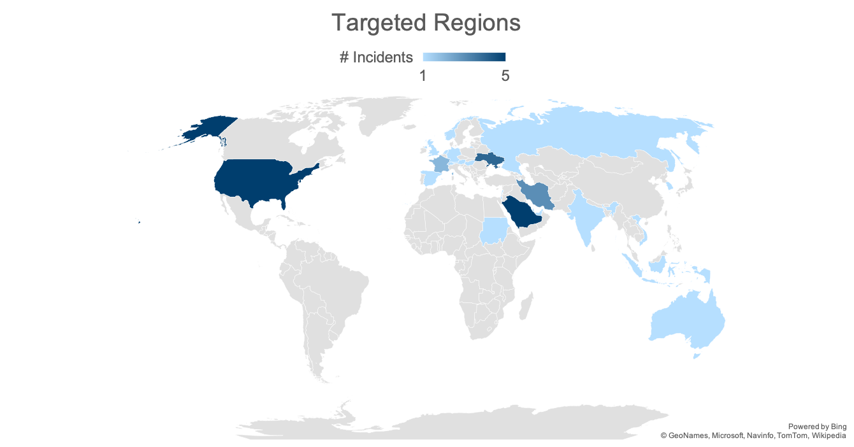
Targets: Geographic Location
Comparative Overview of ICS Security Incidents
13
Notes:
Entities in Europe (Ukraine) are targeted by about 37%
Middle East (Saudi Arabia, Iran) is being targeted by about 33%
19% of the analyzed incidents, the US were amongst the victims
neither Russia nor China nor North Korea report a lot of ICS incidents against entities located in their countries

Slide 14
Threat Actors: Geographic Location
Comparative Overview of ICS Security Incidents
From which countries/regions do ICS attacks originate most often?
14

Slide 15
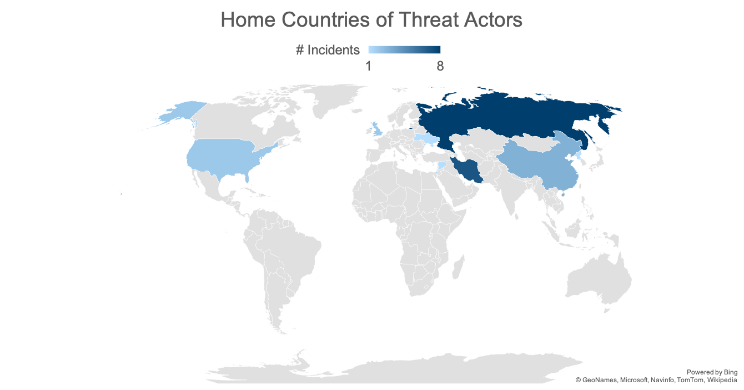
Threat Actors: Geographic Location
Comparative Overview of ICS Security Incidents
15
Notes:
Russia & Middle East

Slide 16
Attack Goals and Motivations
Comparative Overview of ICS Security Incidents
What are typical goals of ICS attacks?
16

Slide 17
Attack Goals and Motivations
Comparative Overview of ICS Security Incidents
Monetary Gain
Information Gain
(Physical) Disruption
17

Slide 18
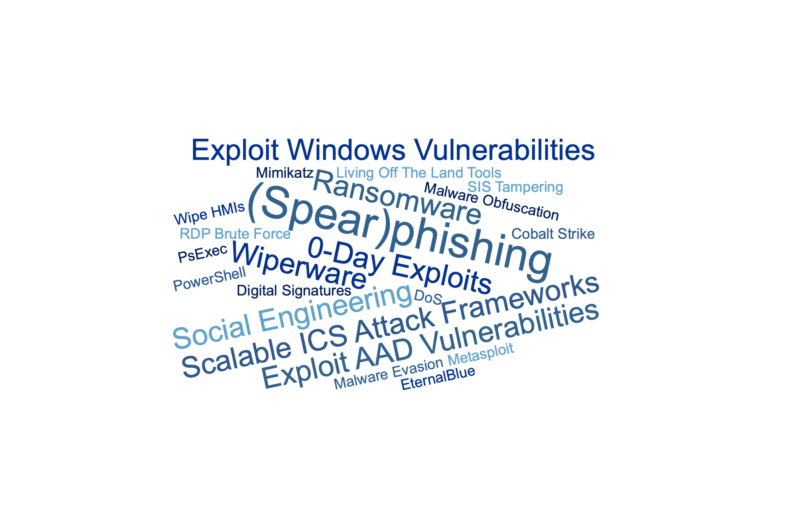
Attack Techniques
Comparative Overview of ICS Security Incidents
18
Notes:
Breach of enterprise IT network: spearphishing
Move to ICS network: improper network isolation
Lateral movement: zero-day exploits, Windows/AAD vulnerabilities
In ICS network: sophisticated obfuscation and evasion techniques and living off the land tools (PowerShell) to trick IDS
Final Payload: Ransomware, Wiperware (Armin: NotPetya)
(Mimikatz: Exploit Windows authentication vulnerabilities (<-> stored passwords))
(Cobalt Strike: Red Teaming tool for post-exploitation tasks)
(PsExec: Remote access programmsimilarto SSH)

Slide 19
Success Rate
Comparative Overview of ICS Security Incidents
What is the success rate of ICS attacks?
19

Slide 20
Success Rate
Comparative Overview of ICS Security Incidents
20
Notes:
Grain of salt: Probably a lot of the unsuccessful attacks don't reach the public

Slide 21
Dwell Times
Comparative Overview of ICS Security Incidents
How long does it take from the initial breach to the execution of the final ICS payload?
21

Slide 22
Dwell Times
Comparative Overview of ICS Security Incidents
Dwell Time of untargetted attacks: Days
Dwell Time of targetted attacks: Months – Years
In theory a lot of time to detect and prevent the execution of a payload
In practice most attacks still are not detected in their early stages
22

Slide 23
Detection and Mitigation Strategies
Comparative Overview of ICS Security Incidents
Proper network segmentation
Reliable backup strategy
Up-to-date asset inventory
Intrusion detection/prevention systems
Vulnerability management solutions
23

Slide 24
Agenda
Motivation & Problem Statement
Comparative Overview of ICS Security Incidents
Case Study: The Triton Attack
Conclusion & Future Work
24
Notes:
[20min]
Simon already talked about it and it came up in the discussion, maybe I can fill some gaps there

Slide 25
Safety Instrumented Systems (SIS)
Case Study: The Triton Attack
Goal: Maintain safe operations and prevent catastrophic events in case of failures of other hard- or software.
Sensors
SIS
Actuators
Temperature
Heater
Is it safe to continue operation?
Preassure
No
Graceful shutdown
Waterpump
.
.
.
.
.
.
Velocity
Yes
Engine
Do nothing
25

Slide 26

The Triton Attack
Case Study: The Triton Attack
Target: Saudi Arabian oil refinery operated by Petro Rabigh
Time of first impact: 2017
http://mcgtechtalk.com/wp-content/uploads/2017/03/spear-phishing.png
26

Slide 27

Attack and Response Strategies
Case Study: The Triton Attack
Still unclear how the ICS network got breached in 2014; possibly through spearphishing
http://mcgtechtalk.com/wp-content/uploads/2017/03/spear-phishing.png
27

Slide 28

Attack and Response Strategies
Case Study: The Triton Attack
Since the network connectivity of the SIS was not strictly limited, the attackers could access it
https://manageditservicesminneapolis.com/importance-computer-network-maintenance-repair-info/
28

Slide 29
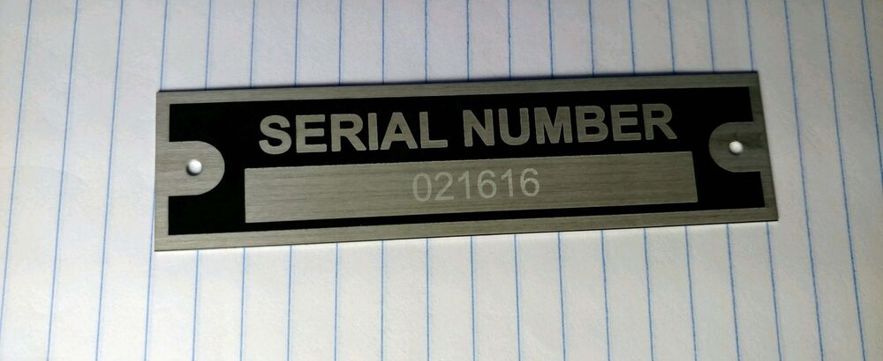
Attack and Response Strategies
Case Study: The Triton Attack
Attackers figured out the exact SIS model and left for two years
https://i.ebayimg.com/images/i/152654640334-0-1/s-l1000.jpg
29
Notes:
Triconics SIS

Slide 30

Attack and Response Strategies
Case Study: The Triton Attack
Since the SIS ran in programming instead of run mode, the Triton malware could be installed
http://hw-img.datpiff.com/m580a552/A-Mase_Two_Years_Later-front-large.jpg
30
Notes:
2017

Slide 31

Attack and Response Strategies
Case Study: The Triton Attack
After installation and execution, the plant tripped gracefully
https://unstrangemind.files.wordpress.com/2016/03/shutdown.jpg
31

Slide 32
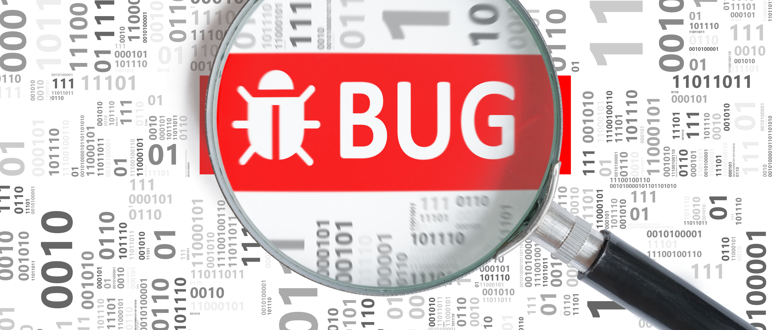
Attack and Response Strategies
Case Study: The Triton Attack
Due to a human error, the malware contained a bug
https://www.beningo.com/wp-content/uploads/2016/03/AdobeStock_100096286.jpeg
32
Notes:
Human error

Slide 33

Attack and Response Strategies
Case Study: The Triton Attack
After some investigations, the plant was brought up again
https://betanews.com/wp-content/uploads/2016/11/Restart-button-keyboard-key-e1479117780695.jpg
33

Slide 34

Attack and Response Strategies
Case Study: The Triton Attack
The attackers got a second chance, tried to fix the bug and installed Triton again
https://betanews.com/wp-content/uploads/2016/08/install-software-laptop.jpg
34

Slide 35
Attack and Response Strategies
Case Study: The Triton Attack
Due to the bug not being patched correctly, the plant tripped again
https://unstrangemind.files.wordpress.com/2016/03/shutdown.jpg
35
Notes:
Human error

Slide 36

Attack and Response Strategies
Case Study: The Triton Attack
Hired ICS security specialists were finally able to identify and remove the malware
https://www.cbronline.com/wp-content/uploads/2017/02/Investigation.jpg
36

Slide 37
Goals, Impacts, and Attribution
Case Study: The Triton Attack
Goal: remains unclear; probably causing disruption; potentionally threatening human lives
Impact: Several weeks of downtime
Attribution: State-sponsored Russian threat group named TEMP.Veles
37
Notes:
Armin: Attribution is hard

Slide 38
Detection and Mitigation Opportunities
Case Study: The Triton Attack
Continuous security awareness trainings can help employees to identify phishing attacks
Restricting the network connectivity of a SIS lowers the possibility of a SIS breach
Under normal circumstances, SIS should always operate in run mode, not in program mode in order to prevent reprogramming of the logic by attackers
38
Notes:
Question from Michael: Not sure how well this strategies are adopted, but this is the way to go

Slide 39
Agenda
Motivation & Problem Statement
Comparative Overview of ICS Security Incidents
Case Study: The Triton Attack
Conclusion & Future Work
39

Slide 40
Conclusion
Attacks are spread across multiple sectors and geographic regions
Key threat actors reside in Russia and the Middle East
The most common goals of ICS attacks are data extraction and causing disruption
Important trends in terms of attack techniques are spearphishing, zero-day exploits, sophisticated obfuscation and evasion techniques, and exploiting Windows/AAD vulnerabilities
Attackers usually reside in the victims’ network for several weeks or months before executing the final payload
40

Slide 41
Conclusion
Proper network segmentation
Reliable backup strategy
Up-to-date asset inventory
Intrusion detection/prevention systems
Vulnerability management solutions
41

Slide 42
Future Work
Add more incidents for higher accuracy and deeper insights
Use an analysis approach that is more qualitative instead of quantitative
Analyze how ICS companies manage to defend against known threats over the course of time
42
Notes:
Core hypotheses to test would be if companies are more likely to defend their in- frastructure successfully against a certain threat the longer it is publicly known and if so, how fast this adaptation of defense strategies happens.
Ioan asked this question after Marisols presentation.

Slide 43
Q & A
43

Slide 44
Q & A
In your research for this semniar, have you come across interesting ICS security incidents?
Do you have further suggestions on how the Triton attack could have been prevented?
44

Slide 45
Backup
45

Slide 46
Analyzed Incidents
Comparative Overview of ICS Security Incidents
46
Notes:
Animate last point bold

Slide 47
Comparative Overview of ICS Security Incidents
Targets
Threat actors
Attack techniques
Attack goals and realized impacts
Dwell times and reactions
Detection and mitigation strategies
47
Notes:
Evtl. rausnehmen

Slide 48
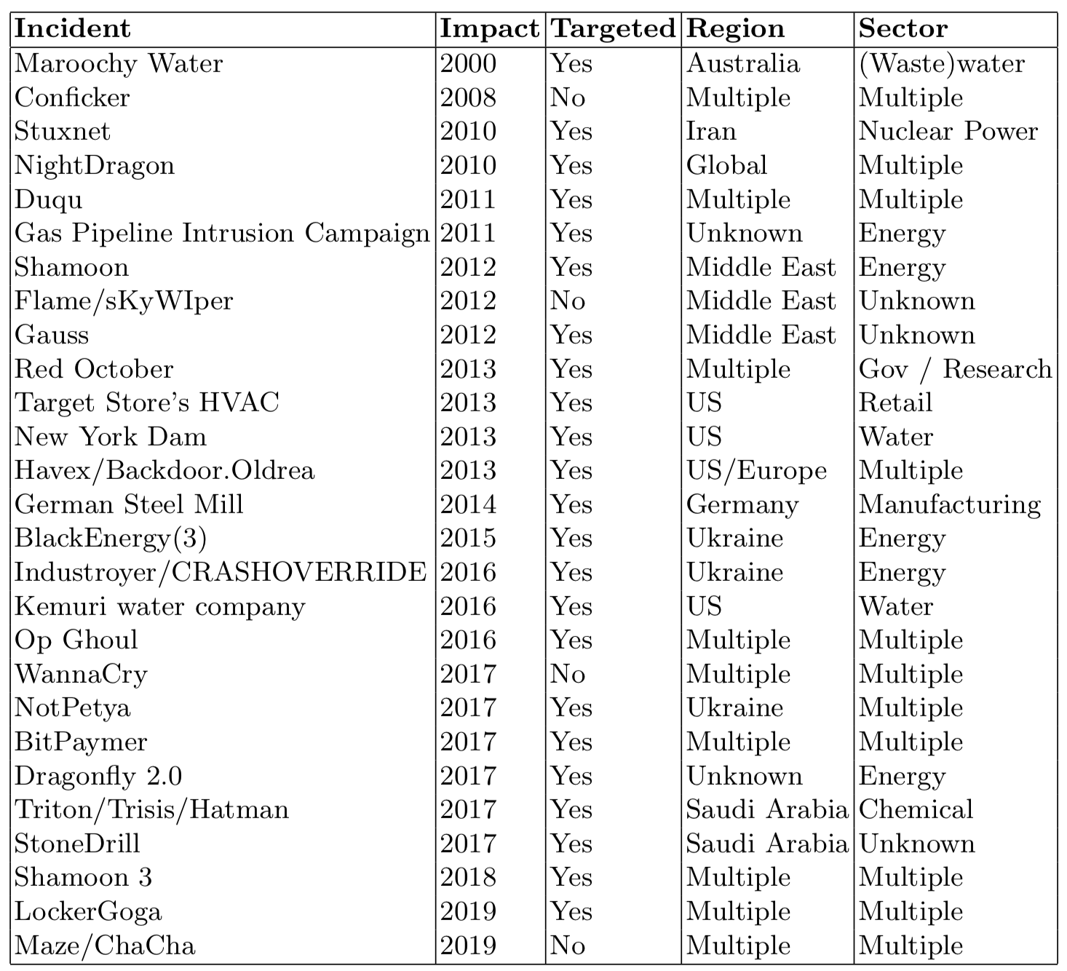
Analyzed Incidents
48
Notes:
Evtl. rausnehmen

Slide 49
Targets: Economic Sector
Comparative Overview of ICS Security Incidents
Aviation
Energy
Government
Manufacturing
(Petro)chemical
(Waste)water
…
49

Slide 50
Threat Actors: Threat Groups
Comparative Overview of ICS Security Incidents
50

Slide 51
Threat Actors: Geographic Location
Comparative Overview of ICS Security Incidents
51

Slide 52
Attack and Response Strategies
Case Study: The Triton Attack
Unclear how the ICS network got breached; possibly through spearphishing
Since the network connectivity of the SIS was not strictly limited, the attackers could access it
Attackers figured out the exact SIS model and left for two years
Since the SIS ran in programming instead of run mode, the Triton malware could be installed
52

Slide 53
Attack and Response Strategies
Case Study: The Triton Attack
After installation and execution, the plant tripped gracefully
Due to a programming error, the malware contained a bug
After some investigations, the plant was brought up again
The attackers got a second chance, tried to fix the bug and installed Triton again
Due to the bug not being patched correctly, the plant tripped again
Hired ICS security specialists were finally able to identify and remove the malware
53

